Slide 1
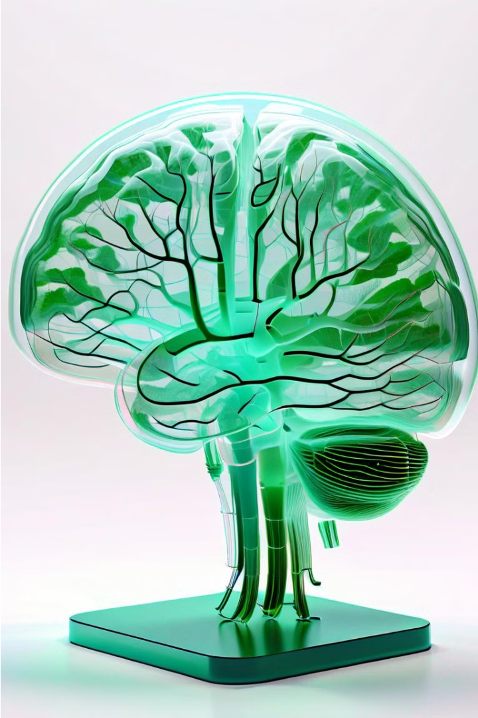

Detection & Report Generation of Brain Tumors using Deep Learning
Leveraging deep learning to identify and analyze brain tumors from medical imaging data.
Team Members:
Sanchi Sharad Satam
Shreya Karunakar Shetty
Avantika Deshmukh
Sanket Khambal
Shubham Shetty

Slide 2
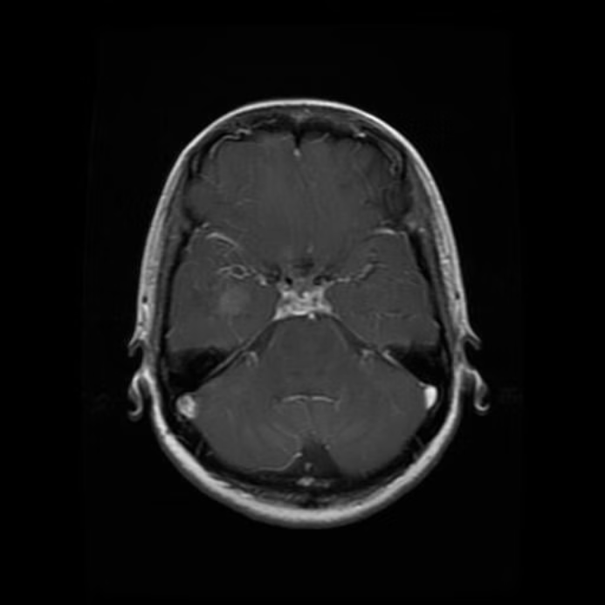
MRI Image

Slide 3
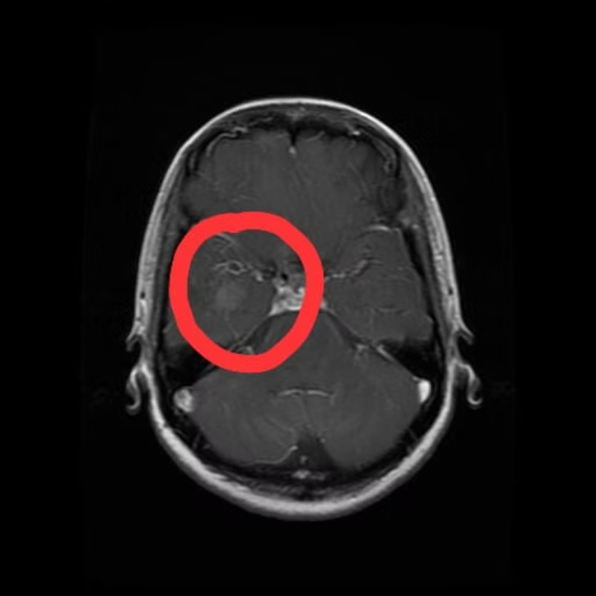

Slide 4

Problem Statement
In this project, we are developing a computer-aided diagnosis (CAD) system capable of automatically detecting the presence of brain tumors in medical images, such as MRI scans. The system is able to differentiate between tumor and non-tumor regions with high accuracy and also highlighting the specific image regions critical for its diagnosis.

Slide 5
Dataset Overview
Imaging Data
Tumor Classes
7023 MRI images
Glioma
5712 Training Images
Meningioma
1311 Testing Images
Pituitary
No tumor

Slide 6
Model Evaluations
SVM and Random Forest
Convolutional Neural Network
Traditional ML models for brain tumor classification
Deep learning model leveraging EfficientNet

Slide 7
Image Preprocessing
Resize images to a uniform size of 224x224 pixels
Apply Gaussian blur with a 5x5 kernel to smooth images
Convert images to grayscale

Slide 8
Feature Extraction
Gabor Features:
GLCM Features:
Extract mean values of real and imaginary parts of Gabor-filtered images.
Compute Grey Level Co-occurrence Matrix (GLCM) at four angles .
Use multiple orientations and frequencies for filtering.
Calculate texture features: contrast, dissimilarity, homogeneity, energy, correlation, and Angular Second Moment (ASM).

Slide 9
Support Vector Machine
Data Preprocessing
Model Training
Model Testing
1
2
3
4
5
Feature Extraction
Model validation

Slide 10
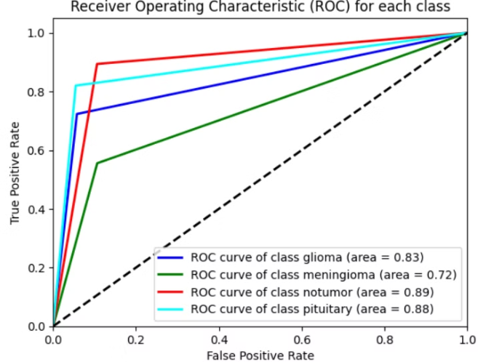
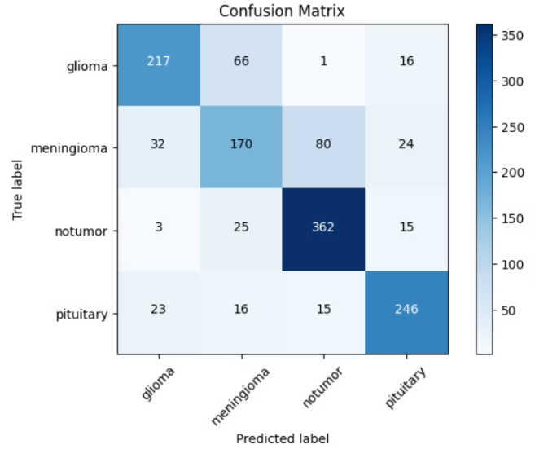
Results

Slide 11
Random Forest Model
Data Preprocessing
Model Training
Model Testing
1
2
3
4
5
Feature Extraction
Model Validation

Slide 12
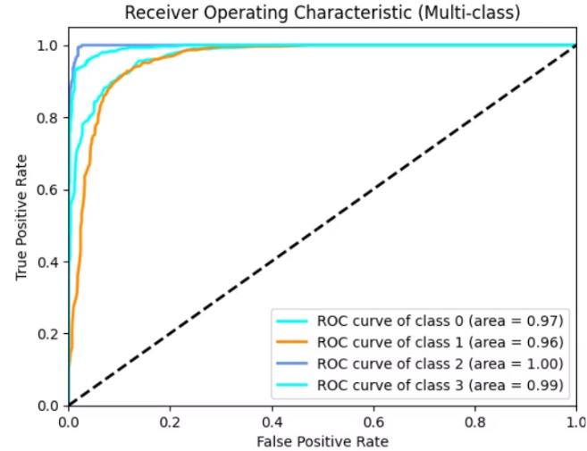
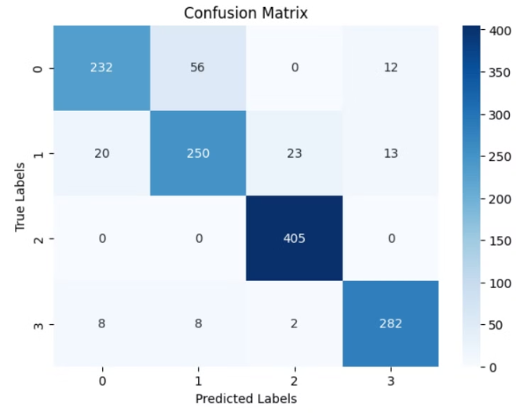
Results

Slide 13
Convolutional Neural Network
Model Development
Data Preparation
Prediction
1
2
3
4
5
6
Feature Extraction
Evaluation
Visualization

Slide 14
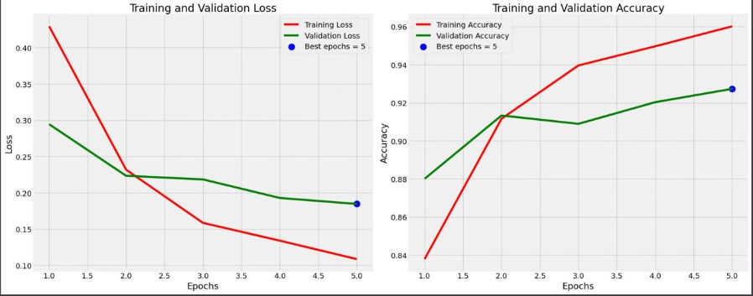
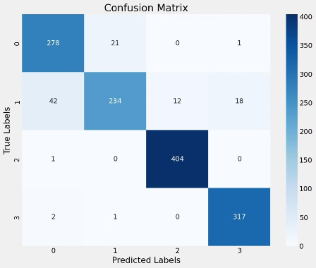
Results

Slide 15
Visualization: Grad-CAM
Grad-CAM
Localization
Interpretability
Gradient-based class activation mapping for explainability
Highlighting the image regions driving the CNN's predictions
Providing insights into the model's decision-making process

Slide 16
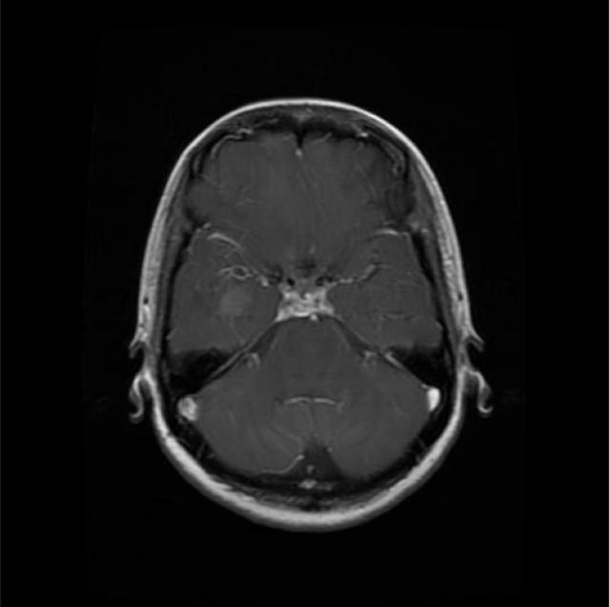
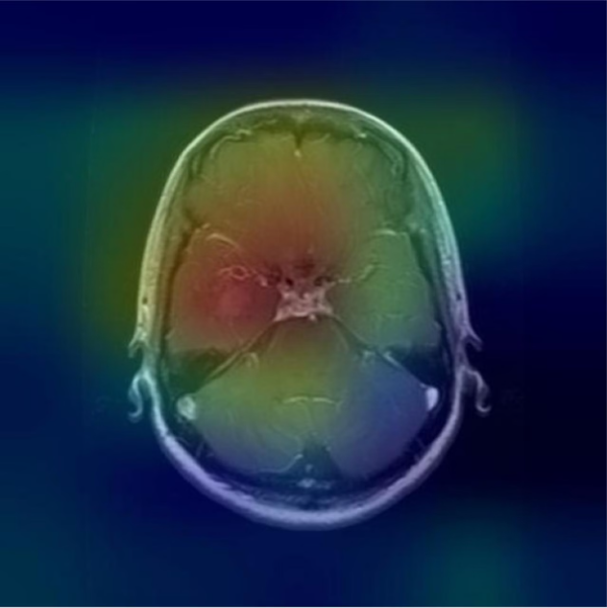
Image Visualization

Slide 17



Reporting and Insights
Model Comparisons
Tumor Localization
Comprehensive Reporting
Comparing efficiencies of traditional models and deep learning model
Highlighted regions of interest in the brain scans
Detailed analysis and findings for clinicians

Slide 18
Thank You!!!

